Slide 1

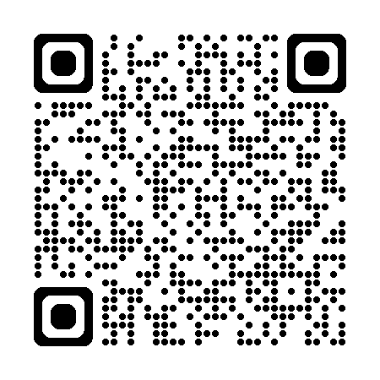
Monday 2nd March
10:00am – 4:00pm
The Centre @ Halton, LA2 6NB – Mobile Clinic

