Slide 1

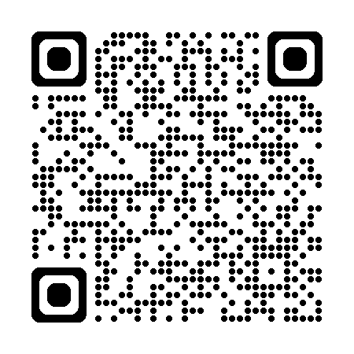
Wednesday 18th February 2026
10.00am – 4.00pm
Salvation Army, 131 Balmoral Road, Morecambe, LA3 1HJ

