Slide 1

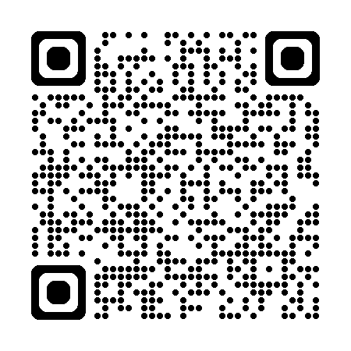
Sunday 8th February 2026
9.00am – 3.00pm
Morecambe Urgent Treatment Centre, Hanover St, LA4 5LY

