Slide 1
WE ARE VIY
Youth | Community | Volunteering

Slide 3
FREE WORK EXPERIENCE AND CAREERS SUPPORT TO SKILL UP AND STAND OUT
We challenge NEET and at risk young people
to learn trade/employability skills and gain City & Guilds accreditations,
whilst helping to renovate local community spaces in need.
Learn new trade skills for free
Work with professional tradespeople
Meet new people, build confidence
Complete short, flexible placements
Earn City & Guilds Entry Level 3 accreditations
Help with a CSCS card and further careers support
More info & our registration process here
Notes:
Free work experience and careers support to skill up and stand out

Slide 4
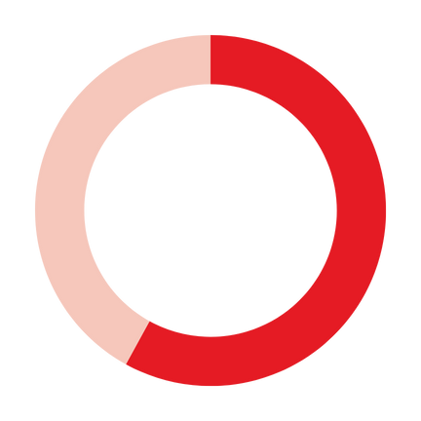
Following their VIY project:
VIY IMPACT: YOUNG PEOPLE
Helping young people, those NEET* and at risk of becoming so,
to learn trade and employability skills, mentored by professional tradespeople
89%
felt happier &
with improved
wellbeing
95%
more confident
about getting a job
in the future
1,520 young people took part last year - aged 14-24
76% achieved at least one City & Guilds accreditation
93%
with increased hopes and aspirations
98%
said VIY was a
positive
experience
39% NEET 16+ progressing to EET within 12 months of VIY*
Data based on 2023-24 financial year (April 2023-March 2024)
*NEET = Not in Education, Employment or Training
**The ‘progression within 12 months’ figure relates to all 16+ NEET learners who have taken part in 2022-23 and 2023-24
We're supported by a range of cross-sector partners, including:

Slide 5
WHO WE WORK WITH
IN 2023-24
Youth work organisations
Schools/colleges/SEN schools/APs/PRUs
Local authority youth/care services
JobCentre Plus
Youth housing charities
Youth offending teams
Refugee organisations
22% VIY LEARNERS WERE FEMALE
OUR YOUNG PEOPLE
46%
of VIY learners were SEN/had a disability/
mental health
condition
14-24 (variable)
NEET
Risk of NEET
Local area resident (variable)
Notes:
Free work experience and careers support to skill up and stand out

Slide 6
FREE CAREERS EXPERIENCE:
ACHIEVING THE
GATSBY BENCHMARKS
A stable careers programme
Learning from career and labour market information
Addressing the needs of each pupil
Linking curriculum learning to careers.
Encounters with employers and employees
Encounters with further and higher education
Experiences of workplaces
Personal guidance
Notes:
Free work experience and careers support to skill up and stand out

Slide 7
NATIONAL REACH.
REGIONAL APPROACH.
LOCAL IMPACT.
OUR KEY HUB REGIONS
North West
Yorks/Humber
North East
East Midlands
West Midlands
London/South East
East of England
South Wales
Notes:
Free work experience and careers support to skill up and stand out

Slide 8
THE VIY EXPERIENCE
More info & our registration process here
FAQs here
How it works
Register via unique online link
Max. 15 mins to complete
Needs assessed with your help
Welcome Call
Welcome Pack
What happens on a project?
Meet the Mentors
H&S briefing/PPE
Mentored on the tools
Breaks and lunch time
Fun times!
Another project?
CSCS card?
Support with further training/careers/links to employers?
How do I register?
What happens next?
PRE
PROJECT
ON
SITE
POST
PROJECT
-Up to 3 weeks pre-project
-Flexible placements
-Support with lunch/travel available where needed
-No prior experience required
-Experience tailored to needs
-Min. 3 days on site for accreditation
-Skills vary per project
-Mentor/Assessor support
-C&G certificate sent in post
-Other work-readiness opps
-Next Steps Guide sent 1 week after final day on project
-Our team can stay in touch for up to 3 months - opportunities shared if opted in
-Character reference available

Slide 9
DAILY TIMETABLE
ACCREDITATION
- timetable tbc -
-Entry Level 3 City & Guilds
-Min. 3 days on site for accreditation (15 guided learning hours)
-Skills vary per project
-Mentor/Assessor support
-C&G certificate sent in post - up to 6 weeks
9.45-10 - Arrival & register
10-10.15 - Induction / H&S
10.15-11.15 - On site
11.15-11.30 - Break
11.30-12.30 - On site
12.30-1.00 - Lunch
1-2 - On site
2-2.15 - Break
2.15-3 - On site
3.00 - End of day - home time!
EXTRAS
-All PPE provided
-30mins careers/employability session where timetable/partnerships allow

Slide 10
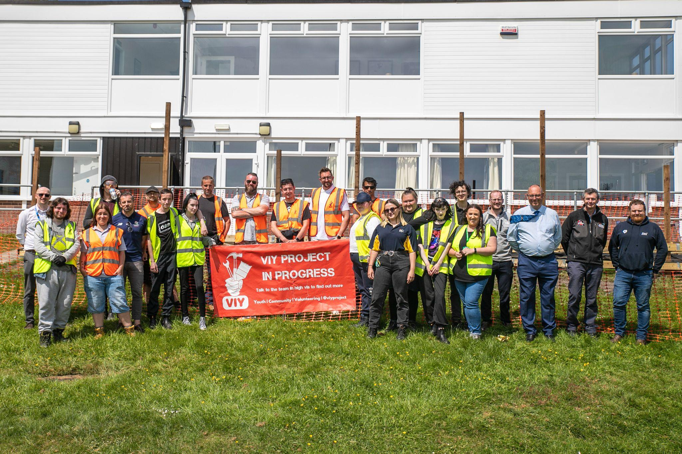
GMCA - Inspiring Generations
Project: Wigan Cricket Club
26 learners completed
22 gained City & Guilds accreditation (%)
10 Individual Referral partners
Groundwork Cheshire, Lancashire, Wigan and Leigh College, Wigan Youth Zone and Wargrave House School
VIY x Inspiring Generations: A Cricket Strategy for Greater Manchester - YouTube
VIY x Inspiring Generations: A Cricket Strategy for Greater Manchester - YouTube
Wigan Sports Club, Decking renovation Project
Notes:
Free work experience and careers support to skill up and stand out

Slide 11
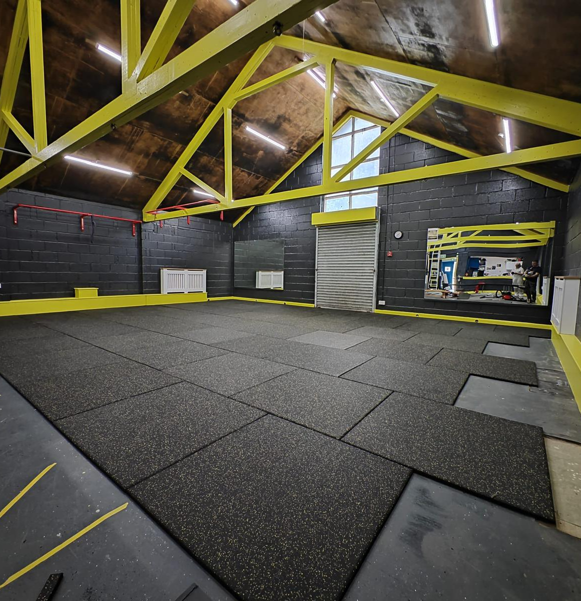
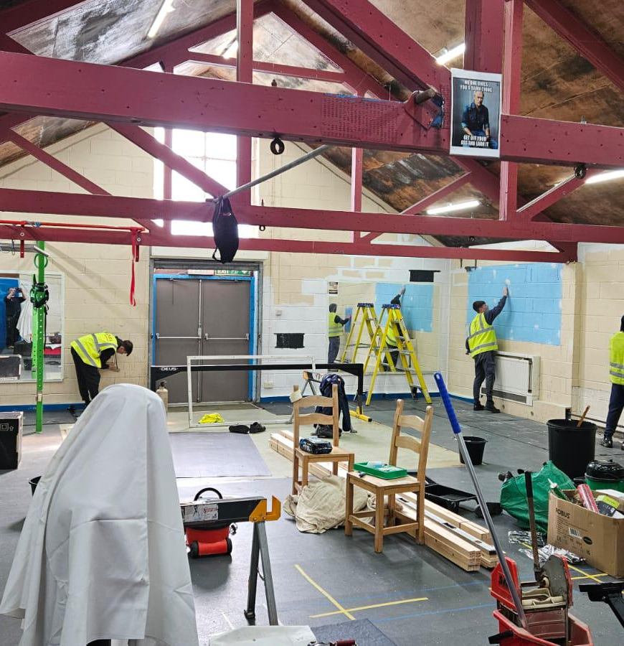
North Yorkshire PCCF -
Project: Westway boxing, Scarborough
21+ learners completed
16+ gained City & Guilds accreditation (%)
5+ Individual Referral partners
North Yorkshire Police/Scarborough Youth Justice Service, either involved or at risk of anti-social behaviour/crime, North Yorkshire Youth Scheme & a local Academy
Lovell supports Scarborough boxing club with PPE donation for essential gym revamp
VIY x Inspiring Generations: A Cricket Strategy for Greater Manchester - YouTube
Magic Youth Club, Claremont, Blackpool
Wigan Sports Club decking renovation Project
Westway Boxing Club, renovation project
Project part-funded by the
UK Shared Prosperity Fund
Notes:
Free work experience and careers support to skill up and stand out

Slide 12
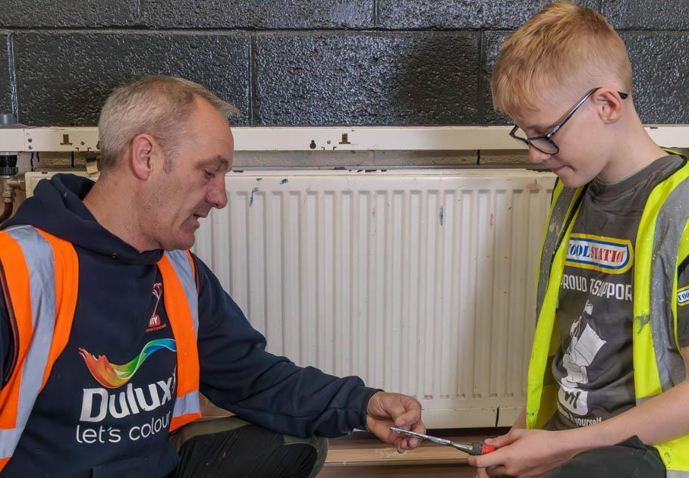
Marsh Estate, Lancaster
Project: Marsh Estate - Refurbishing/Retrofitting Community Centre & Creating New Community Garden
The project involves refurbishing and retrofitting Marsh Community Centre on Marsh Estate in Lancaster and also transforming a derelict piece of land neighbouring the centre into a new community growing garden.
The project will also make the building more energy-efficient/sustainable and reduce energy costs. The new community garden will directly contribute to improved community connectivity, health and wellbeing and directly support local affordable food/healthy eating programmes.
Start date : May 2025
Magic Youth Club, Claremont, Blackpool
Wigan Sports Club decking renovation Project
Marsh Estate, renovation project
Project part-funded by the
UK Shared Prosperity Fund
Notes:
Free work experience and careers support to skill up and stand out

Slide 13
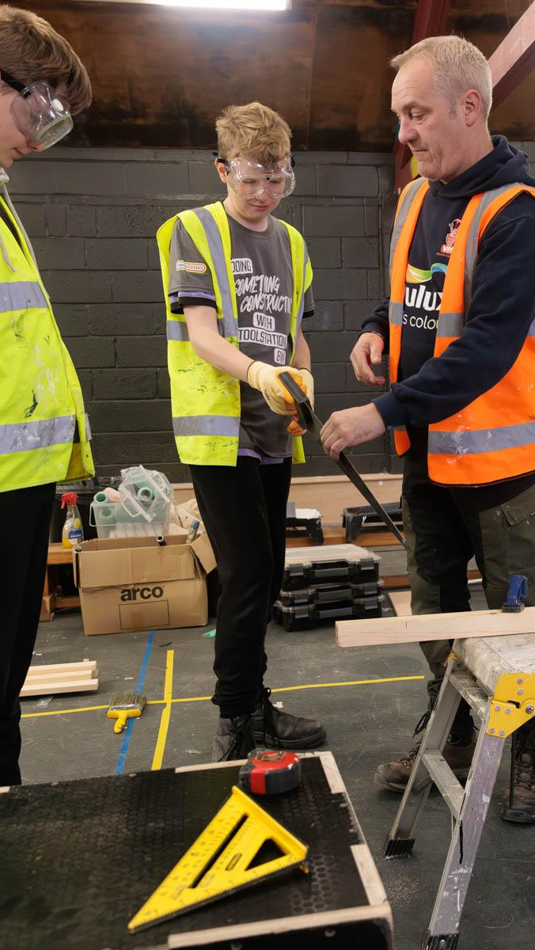
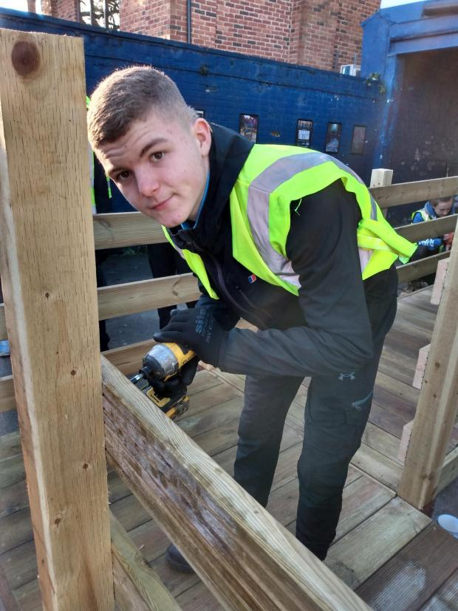
We all hope to go into ‘hands-on’ trades such as bricklaying, roofing or joinery one day.
Rocco admitted that one thing he learned from his time working in the pub was how to saw wood properly. “It’s not as easy as it looks!” he admitted.
He and his mate Marley have been inspired by their time on the project to build a new garden shed for Marley’s nan.
They’ve already got the wood in, and plan to start work on the shed this weekend. Marley said his nan was ‘very happy about it’. “There will be less grass for her to cut in the summer!” he said. Rocco
“We're over the moon with the beginning of our transformation - our vision for our existing building has been brought to life by VIY and the local young people who've supported this project. We can't wait for the next step in our future transformation now!” Ryan, Owner & Founder of Westway Boxing Club

Slide 14
SOUND GOOD? LET'S CHAT
matt@teamviy.com | 07544854193 | @viyproject | volunteerityourself.org | VIY in action

