Slide 1
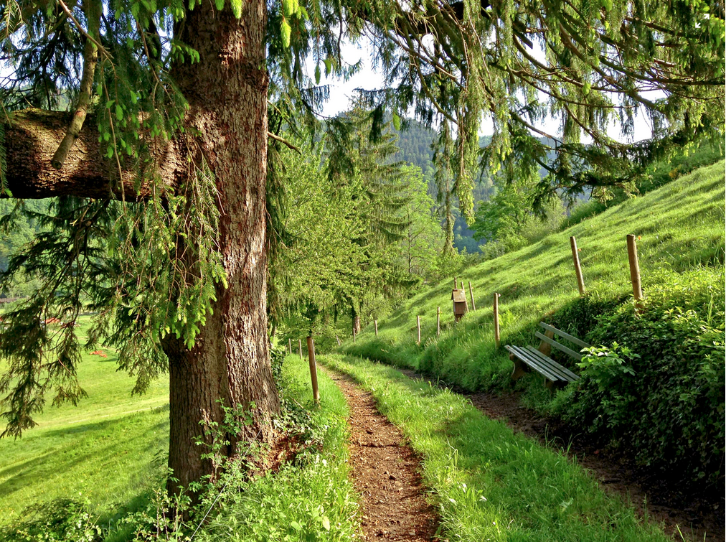
Moving together through your changing world
There is lots of evidence that mental health is improved by taking part in physical activity, but this can feel like a daunting task for new mothers.
There is also a great deal of evidence that spending time in nature- particularly under trees can boost your immune system and improve your mood.
Finding just an hour a week to do something that helps you reconnect with your own needs can reduce the likelihood of mental health problem in the perinatal period.
We will be facilitating 2 wellbeing walks for all to come along for a chat and stroll (Well behaved dogs on leads welcome).
Wellbeing Walks:
Avenham Park, Preston- Meeting outside the front of the Continental Public House South Meadow Lane –Tuesday-30.04.24 13.00 to 14.00
Worden Park, Worden Lane, Leyland- Meeting in the Main Carpark-near to the dog wash area-
-Tuesday -30.04.24 15.00-16.00

