Slide 1
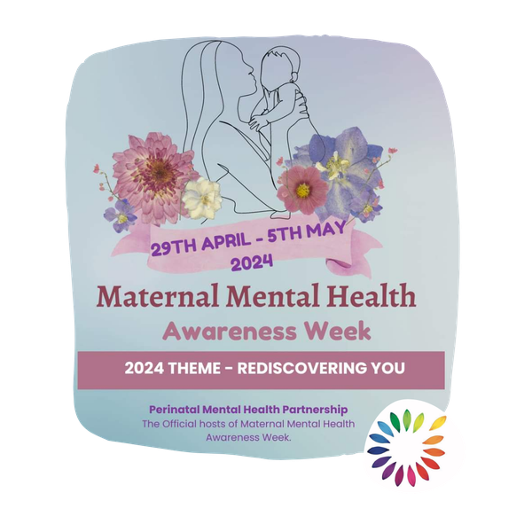
Perinatal positivity pot:
Am I being a good mum? Am I doing the right thing?
Many new parents feel too worried to share how they are feeling as a new parent, here are a few common stories that we hear:
It would be great if you could feel able to share your stories with other new parents about your journey to becoming a parent and you fears and recovery stories.
I felt lost, but when I spoke about it with my health visitor, I was able to find myself in the midst of my new role of being a mum.
I felt like a carer for my baby, I dreaded the long days alone with him, but after completing the Circle of Security Parenting course I felt like a mum and looked forward to sharing the day with him.

